Slide 1


CSCE 5640 Operating System Design Operating System Structures
Dr. Amar Maharjan
Computer Science and Engineering
University of North Texas
Slides (with some modifications) from:
Operating System Concepts – Silberschatz, Galvin and Gagne © 2018
Notes:
It talks about structure.

Slide 2
Outline
Operating System Services
User and Operating System-Interface
System Calls
System Services
Linkers and Loaders
Design and Implementation
Operating System Structure
Building and Booting an Operating System

Slide 3
Operating System Services
An Operating System provides an environment for the execution of program.
Service provider to programs and to the users of those programs.
Common services are available in different operating systems.
One set of operating system services (helpful to users):
User interface (UI)
Almost all OSes have a UI.
Graphical user interface (GUI), Touch-screen interface, Command-line interface (CLI).
Program execution
Load a program into memory, run the program.
End its execution - normally or abnormally (indicating error).
I/O operations
A running program may require I/O, which may involve a file or an I/O device.
Users usually cannot control I/O devices directly, so OS must provide a means to do I/O.
Notes:
Any OS must have some kind of interface, it can be a GUI or CLI or Touch-screen interface (Any).
As user we must be able to access a program (Ex: Opening browser)
At end of the program, it should be terminated properly.
Some operation cannot be done by user like reading a file from some place, this must be provided by the OS.

Slide 4
Operating-System Services (contd.)
One set of operating system services (contd.):
File-system manipulation
Programs need to read and write files and directories, create and delete them, search them, list file Information, permission management.
Communications – Processes may exchange information, on the same computer or between computers over a network
Communications may be via shared memory or through message passing (packets moved by the OS)
Error detection – OS needs to be constantly aware of possible errors
May occur in the CPU and memory hardware, in I/O devices, in user program
For each type of error, OS should take the appropriate action to ensure correct and consistent computing
Debugging facilities can greatly enhance the user’s and programmer’s abilities to efficiently use the system
Possible actions: halt the system, terminate an error causing process, or return an error code to a process
Notes:
Hardware error: memory error or a power failure
I/O devices: a parity error on disk, a connection failure on a network, or a lack of paper in the printer
User program: an arithmetic overflow or an attempt to access an illegal memory location
File-system manipulation: Mac example finder. There should be a way to navigate folders.
Communication: There must be some kind of funcationality so that information can be send between different programs. Ex: Sending mail or sending file to another process in different systems.
Message passing: Who is sending?, where to send? all these informations.
Error detections: All the errors must be detected and handled by the OS.\

Slide 5
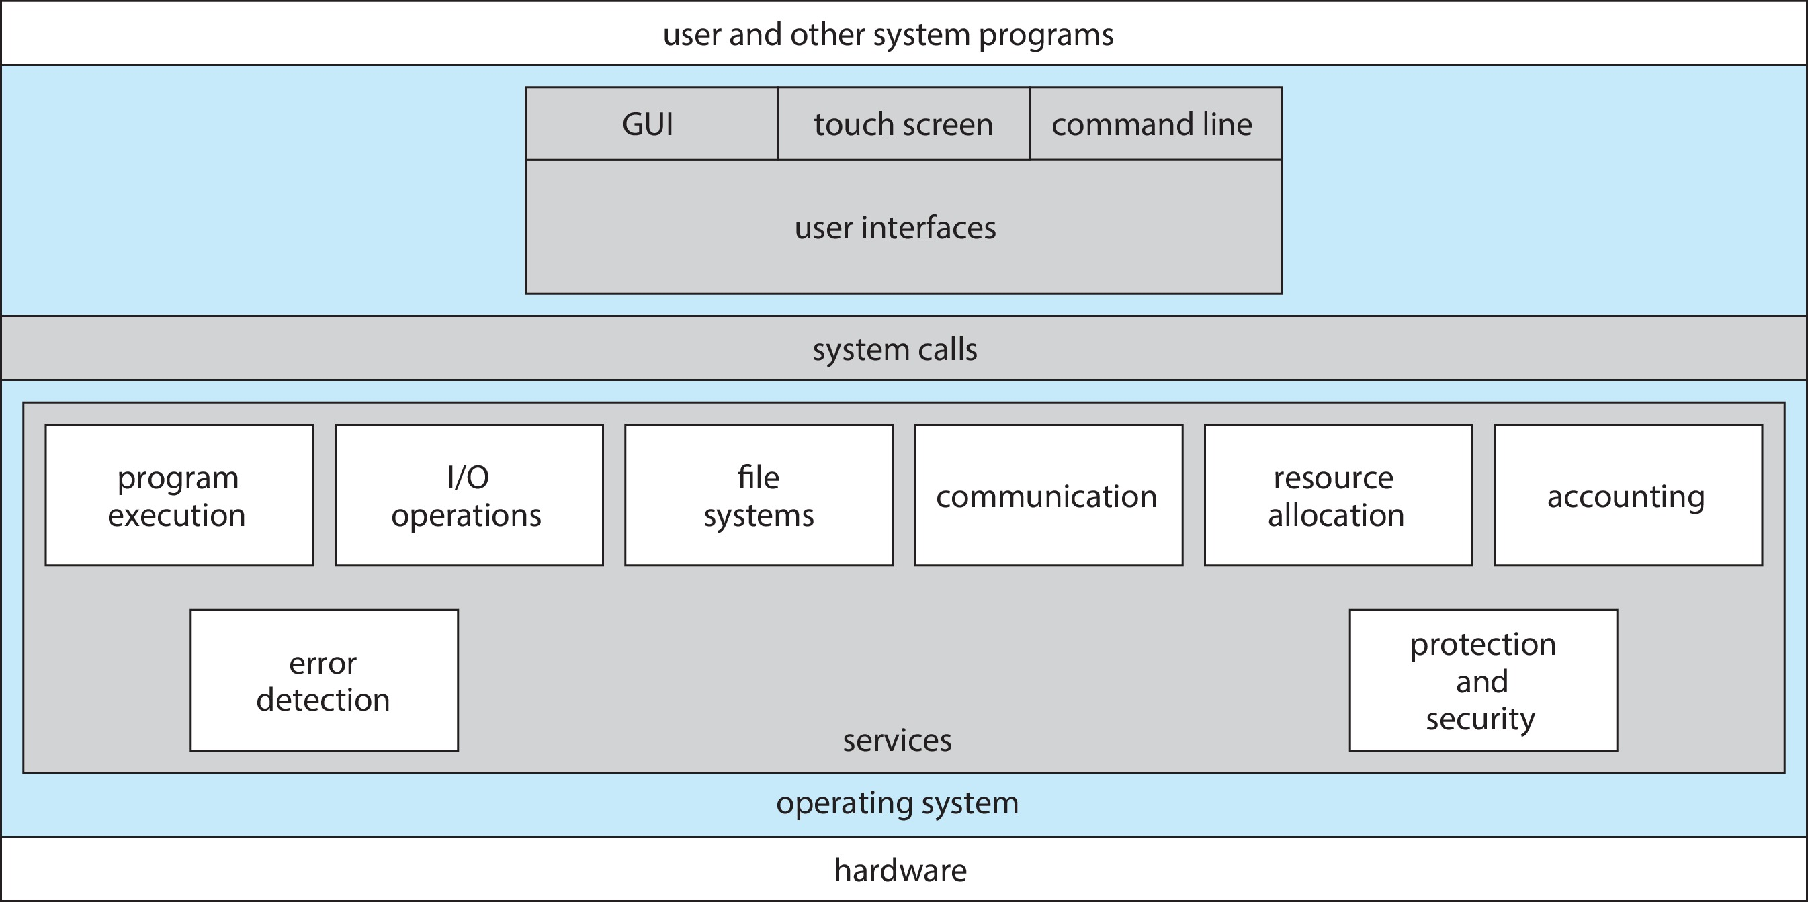
A view of Operating System Services
Notes:
Hardware is hidden from the user.
And OS must provide all these services (maybe more also).
System calls: Typically written in c/c++.

Slide 6
Operating-System Services (contd.)
Another set of OS functions exists for ensuring the efficient operation of the system itself via resource sharing
Resource allocation - When multiple users or multiple jobs running concurrently, resources must be allocated to each of them
Many types of resources - CPU cycles, main memory, file storage, I/O devices.
Logging - To keep track of which users use how much and what kinds of computer resources
Protection and security
Protection involves ensuring that all access to system resources is controlled
Security of the system from outsiders requires user authentication, extends to defending external I/O devices from invalid access attempts
Notes:
From an OS perspective, it also needs some system calls that must be provided.
Protections means within the system, resources from one user must not be accessible to another user.
Security means any malicious user should not be able to access the system. It should not be hackable.

Slide 7
User and Operating System Interface
Three fundamental approaches:
Command-line interface or command interpreters
Graphical User Interface
Touch-Screen Interface

Slide 8
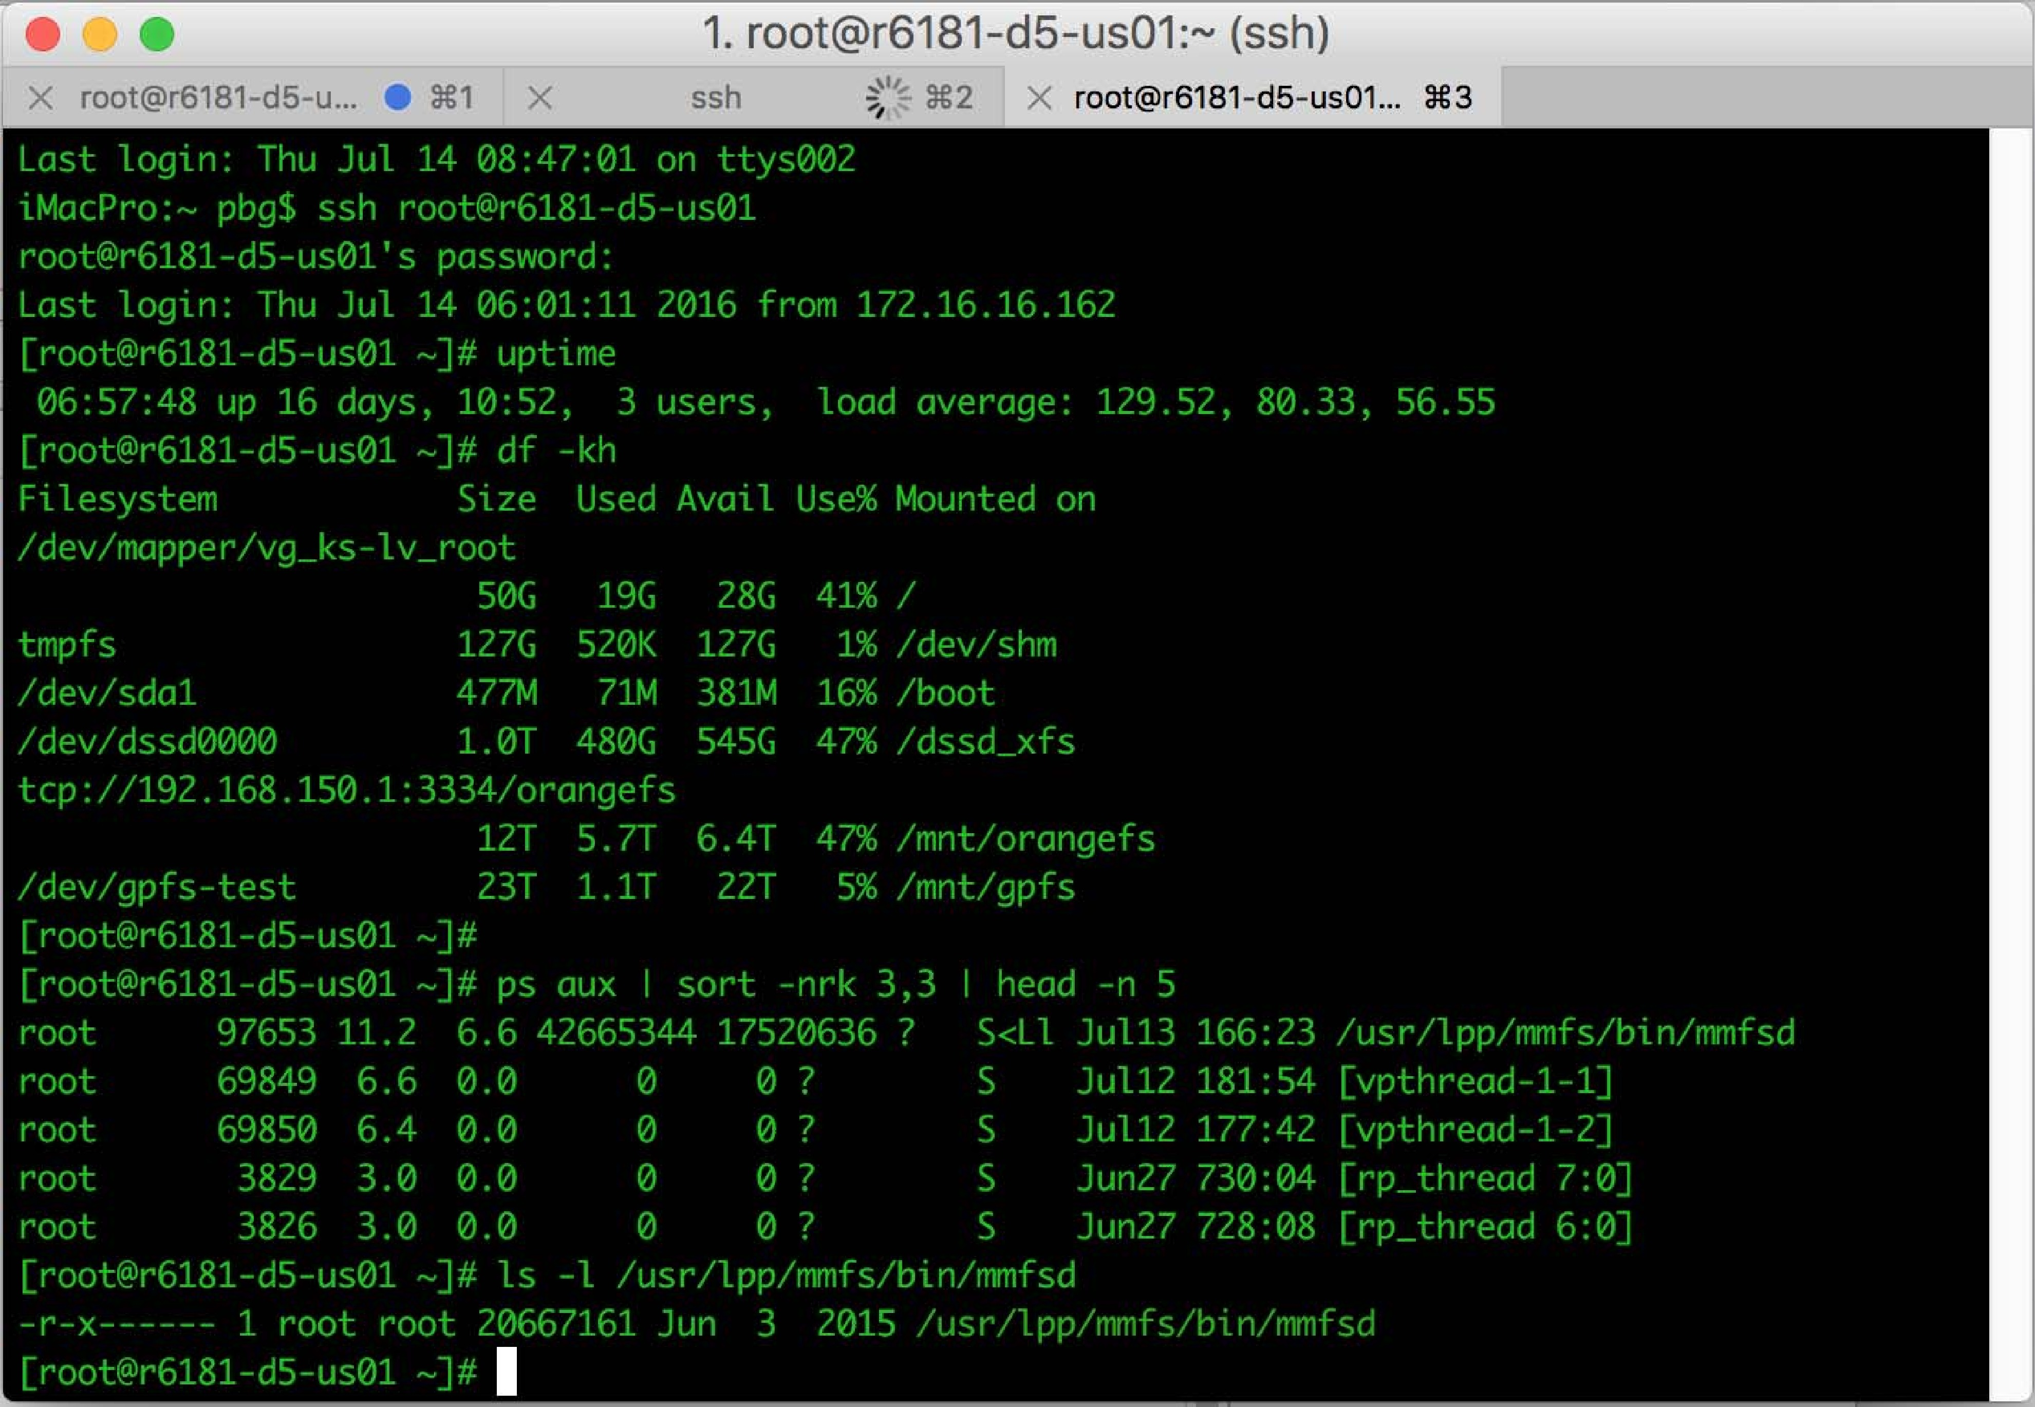
Command Line Interpreter
CLI allows direct command entry
Sometimes multiple flavors implemented – shells
C shell, Bourne-Again shell, Korn shell
Primarily fetches a command from user and executes it
Two approaches of implementation:
Commands built-in, i.e., implement commands itself in the CLI
Just names of programs (loading programs) - adding new features doesn’t require shell modification
Bourne-Again Shell (bash) Command Interpreter
Notes:
The UNIX command to delete a file
rm file.txt
would search for a file called rm, load the file into memory, and execute it with the parameter file.txt.
The logic associated with the rm command would be defined completely by the code in the file rm.
How it executes the command.
1st approach: It will take the command – take all the aurguments and execute it.
2nd approach: All the names and commands are located in one director (Ex: /usr/bin/ in linux contains pre existing commands like copy (/usr/bin/cp – contains code to copy), remove, etc) and CLI invokes/runs the command. Benefit: If you want to add new feature, just add it in that file.

Slide 9
User Operating System Interface - GUI
User-friendly desktop metaphor interface
Usually mouse, keyboard, and monitor
Icons represent files, programs, actions, etc
Various mouse buttons over objects in the interface cause various actions (provide information, show menus, execute function, open directory - folder)
Invented at Xerox PARC – early 1970s
Many systems now include both CLI and GUI interfaces
Microsoft Windows is GUI with CLI "command" shell
Apple Mac OS X is "Aqua" GUI interface with UNIX kernel underneath and shells available
Unix and Linux have CLI with optional GUI interfaces (KDE, GNOME)
Notes:
K Desktop Environment (KDE)
GNU Network Object Model Environment (GNOME)

Slide 10
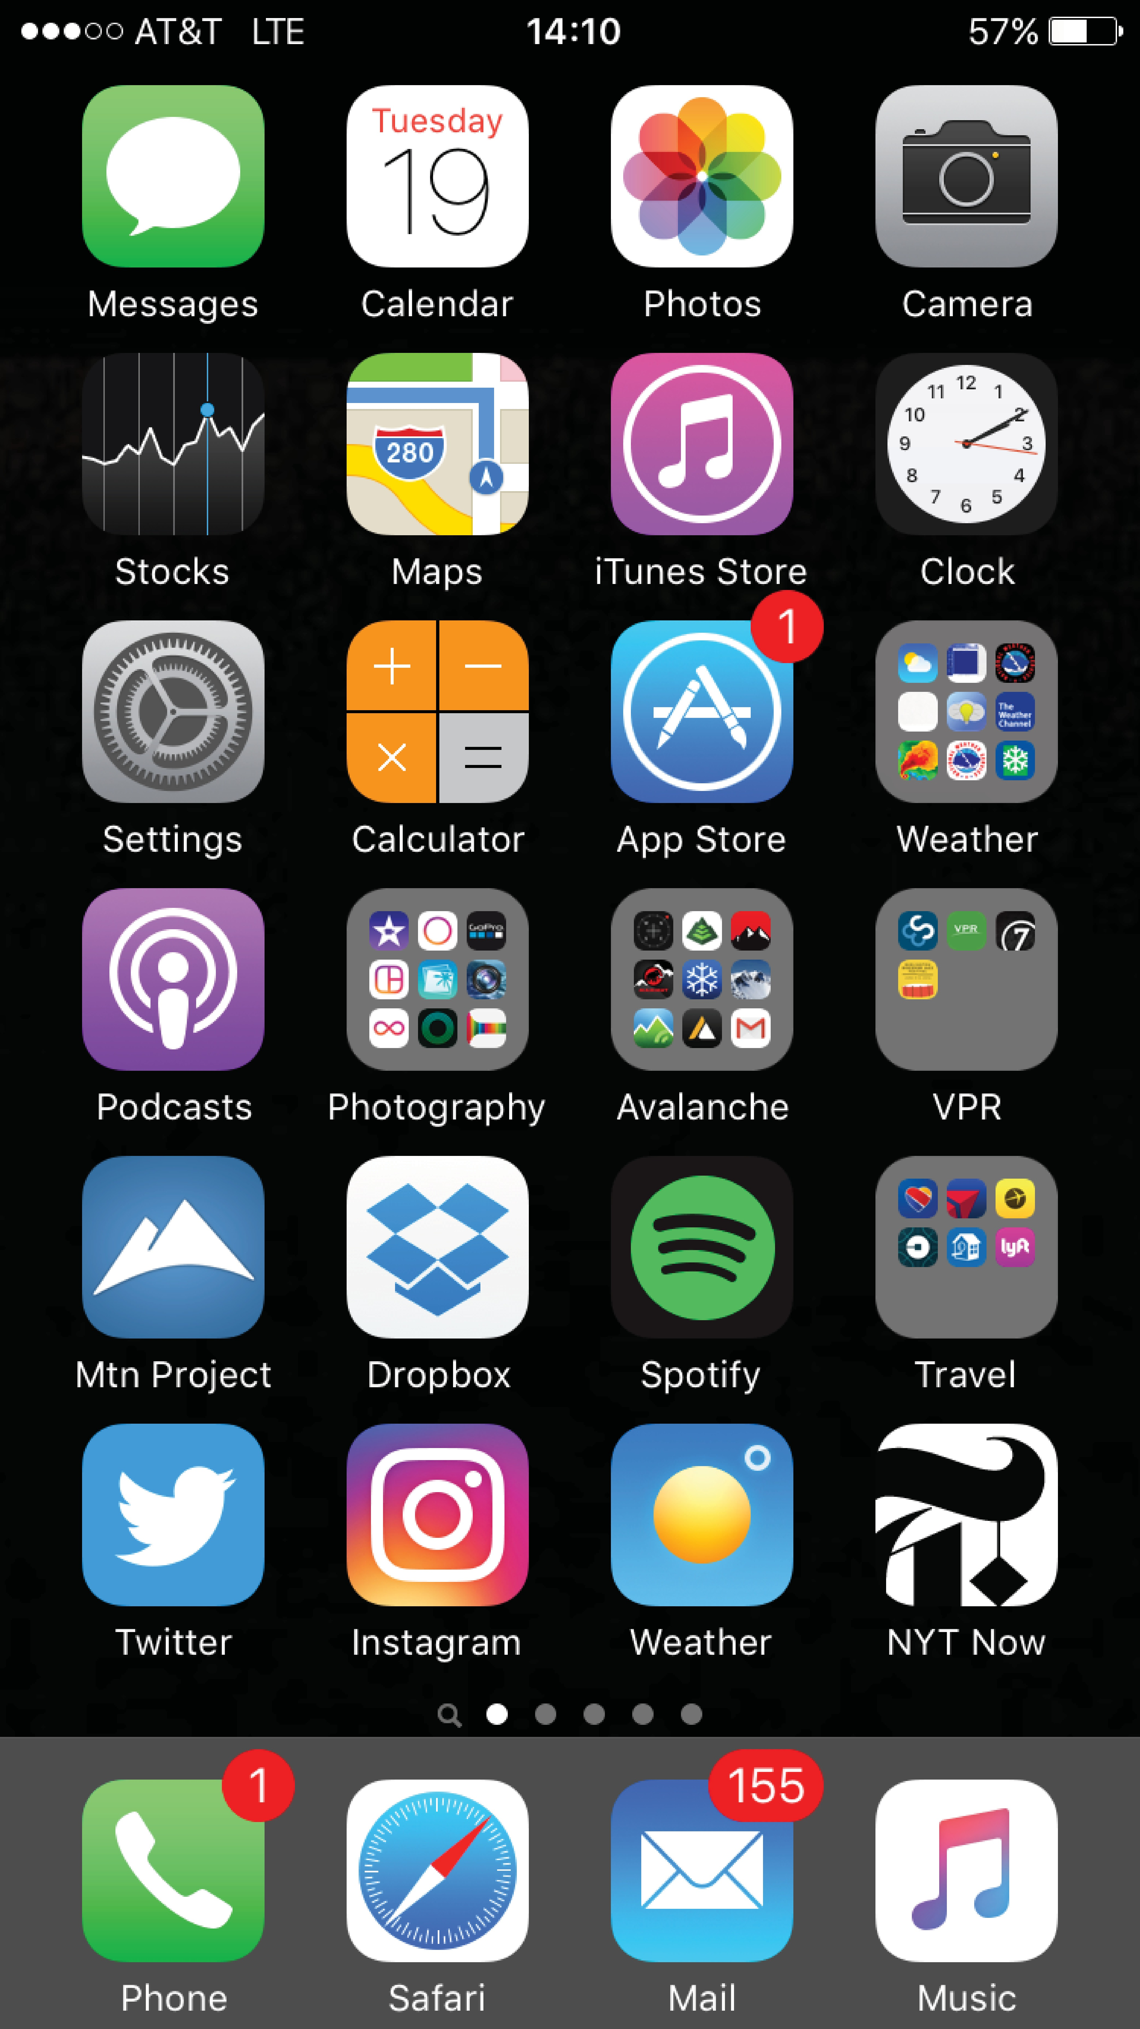
Touch-Screen Interface
Used in mobile systems, smartphones, handheld tablets.
Touchscreen devices require new interfaces
Mouse not possible or not desired
Actions and selection based on gestures – pressing and swiping fingers
Virtual keyboard for text entry
Voice commands
Apple’s Siri
Google Assistant
The iPhone touch screen.
Notes:
Nowadays in Windows we can see multiple UI in one OS like touch.

Slide 11
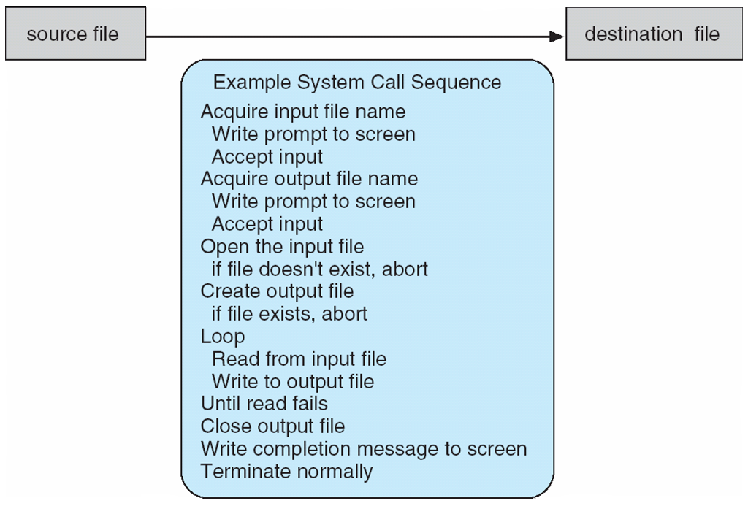
System Calls
Programming interface to the services provided by the OS
Typically written in a high-level language (C or C++)
System call sequence to copy the contents of one file to another file: cp in.txt out.txt
Notes:
Blue box: These things can happen when executing the copy command.
Write, accept, open, create are system calls.
We may be looping 100 or 1000’s of time. Read and write a few bytes.

Slide 12
Application Program Interface (API)
Mostly accessed by programs via a high-level Application Programming Interface (API) rather than direct system call use
Three most common APIs are
Win32 API for Windows,
POSIX API for POSIX-based systems (including virtually all versions of UNIX, Linux, and Mac OS X), and
Java API for the Java virtual machine (JVM)
Why use APIs?
Program portability
Supporting run-time environment (RTE)
Notes:
Note that the system-call names used throughout this text are generic.
run-time environment (RTE) — the full suite of software needed to execute applications written in a given programming language, including its compilers or interpreters
as well as other software, such as libraries and loaders.
API benefit: Portability – We can port from one OS to another just be re-compiling
Multiple language like java or python can support run-time environment. We need RTE to execute the program. By-default C and C++ RTE are pre-installed in the systems.

Slide 13
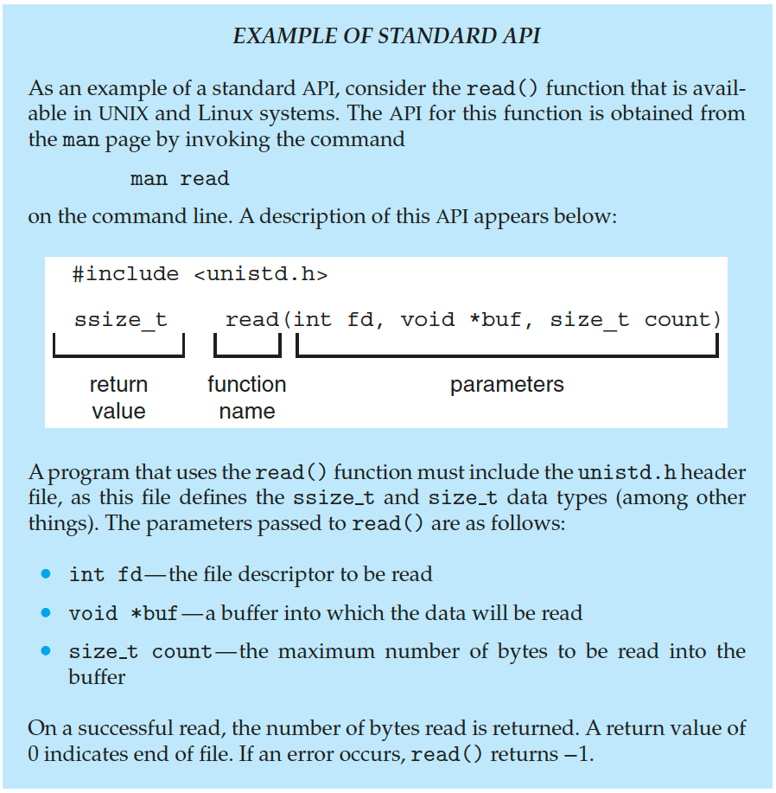
Example of Standard API
Notes:
Ex: int fd = open(“in.txt”, “r”)
fd is a unique integer given by OS. If fd is 0 or -1 then it's an error.
man - its manual (Linux manual category 2 are system calls, manual category 3 is API calls)
If the total file size is 10 bytes and the capacity is 4 bytes. It will copy 1st 4 bytes, then the next 4 bytes, and then the last 2 bytes.

Slide 14
System Call Implementation
Typically, a number is associated with each system call
System-call interface maintains a table indexed according to these numbers
The system call interface invokes the intended system call in OS kernel and returns status of the system call and any return values
The caller need know nothing about how the system call is implemented
Just needs to obey API and understand what OS will do as a result call
Most details of OS interface hidden from programmer by API
Managed by run-time support library (set of functions built into libraries included with compiler)

Slide 15
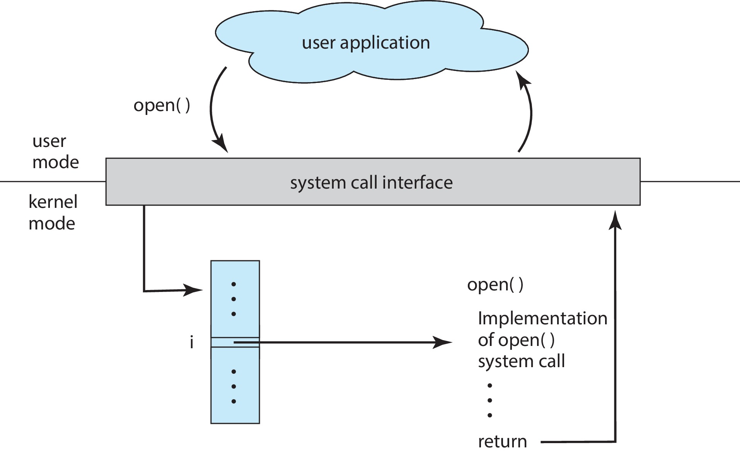
API – System Call – OS Relationship
The handling of a user application invoking the open() system call.
Notes:
Maintains the index (Blue box).
Ex: printf in c language is not a system call but it invokes the system, call.

Slide 16
Types of System Calls
Six major categories: process control, file management, device management, information maintenance, communications, and protection.
Process control
create process, terminate process (end or abort)
load, execute
get process attributes, set process attributes
wait for time
wait event, signal event
allocate and free memory
Notes:
Dump memory if an error
Debugger for determining bugs, single-step execution
Locks for managing access to shared data between processes
Ex: Linux we use fork to create processes.
Load and execute: Once creating a process, what work it should do (meaningful operation).
Wait for time: Ex: Main process created a child process, some case main process want to know the result returning from child process. The the parent process must explicitely tell the that I want to wait for result.

Slide 17
Types of System Calls (Cont.)
File management
create file, delete file
open, close file
read, write, reposition
get and set file attributes
Device management
request device, release device
read, write, reposition
get device attributes, set device attributes
logically attach or detach devices
Notes:
Reposition: Put the reading position in some other place instead of at the start.

Slide 18
Types of System Calls (Cont.)
Information maintenance
get time or date, set time or date
get system data, set system data
get and set process, file, or device attributes
Communications
Two common models for interprocess communication: message-passing and shared-memory
create, delete communication connection
send, receive messages if message passing model to host name or process name
From client to server
Shared-memory model create and gain access to memory regions
transfer status information
Notes:
Information: Metadata – Who has access to the file, etc.
Once we have done with communication we need to explicitly delete the memory.

Slide 19
Types of System Calls (Cont.)
Protection
Control access to resources
Get and set permissions
Allow and deny user access

Slide 20
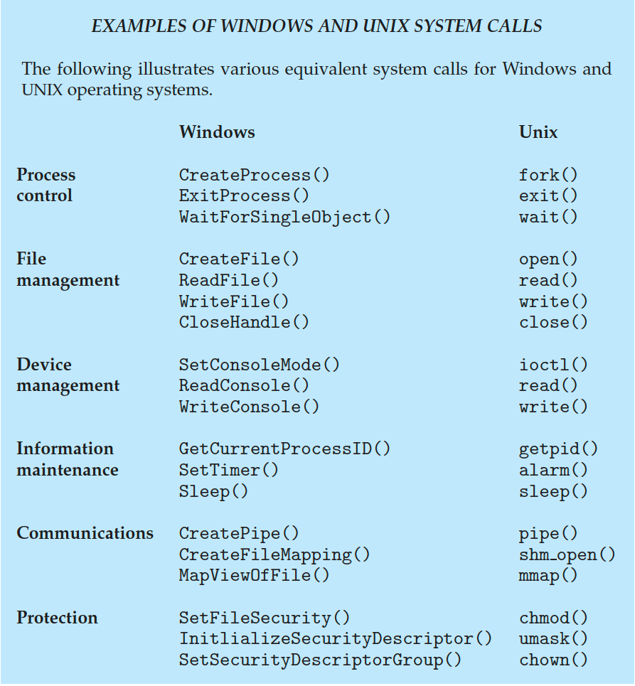
Examples of Windows and Unix System Calls
Notes:
Whoever calls the exit process – that process will the killed immediately.
Pipe is for inter-process communication.
Chmod: Change the attributes of a file. (Ex: Read-write permission attributes)

Slide 21
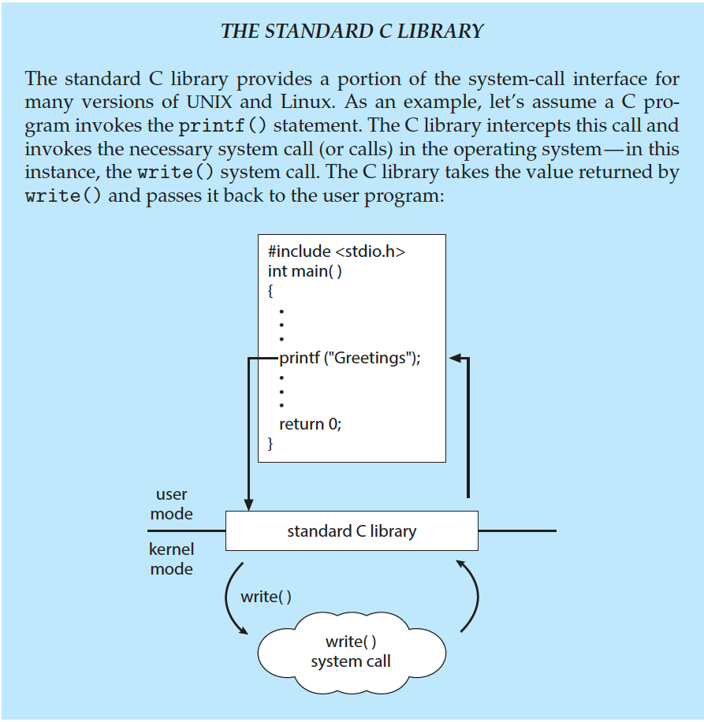
Standard C Library Example
C program invoking printf() library call, which calls write() system call
Notes:
printf() is not a system call but it invokes a system call write().

Slide 22
System Services
System programs provide a convenient environment for program development and execution. They can be divided into:
File manipulation
Status information sometimes stored in a file
Programming language support
Program loading and execution
Communications
Background services
Application programs
Most users’ view of the operating system is defined by application and system programs, not the actual system calls
Notes:
Helps users to solve basic problems like file creation, etc.

Slide 23
System Services (Cont.)
File management - Create, delete, copy, rename, print, dump, list, and generally manipulate files and directories
Status information
Some ask the system for info - date, time, amount of available memory, disk space, number of users
Others provide detailed performance, logging, and debugging information
Typically, these programs format and print the output to the terminal or other output devices
Some systems implement a registry - used to store and retrieve configuration information
Notes:
Registry: Retrieve information about the process.

Slide 24
System Services (Cont.)
File modification
Text editors to create and modify files
Special commands to search contents of files or perform transformations of the text
Programming-language support - Compilers, assemblers, debuggers and interpreters sometimes provided
Program loading and execution- Absolute loaders, relocatable loaders, linkage editors, and overlay-loaders, debugging systems for higher-level and machine language
Communications - Provide the mechanism for creating virtual connections among processes, users, and computer systems
Allow users to send messages to one another’s screens, browse web pages, send electronic-mail messages, log in remotely, transfer files from one machine to another

Slide 25
System Services (Cont.)
Background Services
Launch at boot time
Some for system startup, then terminate
Some from system boot to shutdown
Provide facilities like disk checking, process scheduling, error logging, printing
Run in user context not kernel context
Known as services, subsystems, daemons
Application programs
Don’t pertain to system
Run by users
Not typically considered part of OS
Launched by command line, mouse click, finger poke

Slide 26
Linkers and Loaders
Source code compiled into object files designed to be loaded into any physical memory location – relocatable object file
Linker combines these into single binary executable file
Also brings in libraries
Program resides on secondary storage as binary executable
Must be brought into memory by loader to be executed
Relocation assigns final addresses to program parts and adjusts code and data in program to match those addresses
Modern general-purpose systems don’t link libraries into executables
Rather, dynamically linked libraries (in Windows, DLLs) are loaded as needed, shared by all that use the same version of that same library (loaded once)
Object, executable files have standard formats, so operating system knows how to load and start them
Notes:
Object files are not executable files. It contains binary information.
Linkers: Combine the object files to make a single executable file.
Loaders: Loads a program into a specific memory location.
If it is linked statically then the executable file will be larger than dynamical linking.

Slide 27
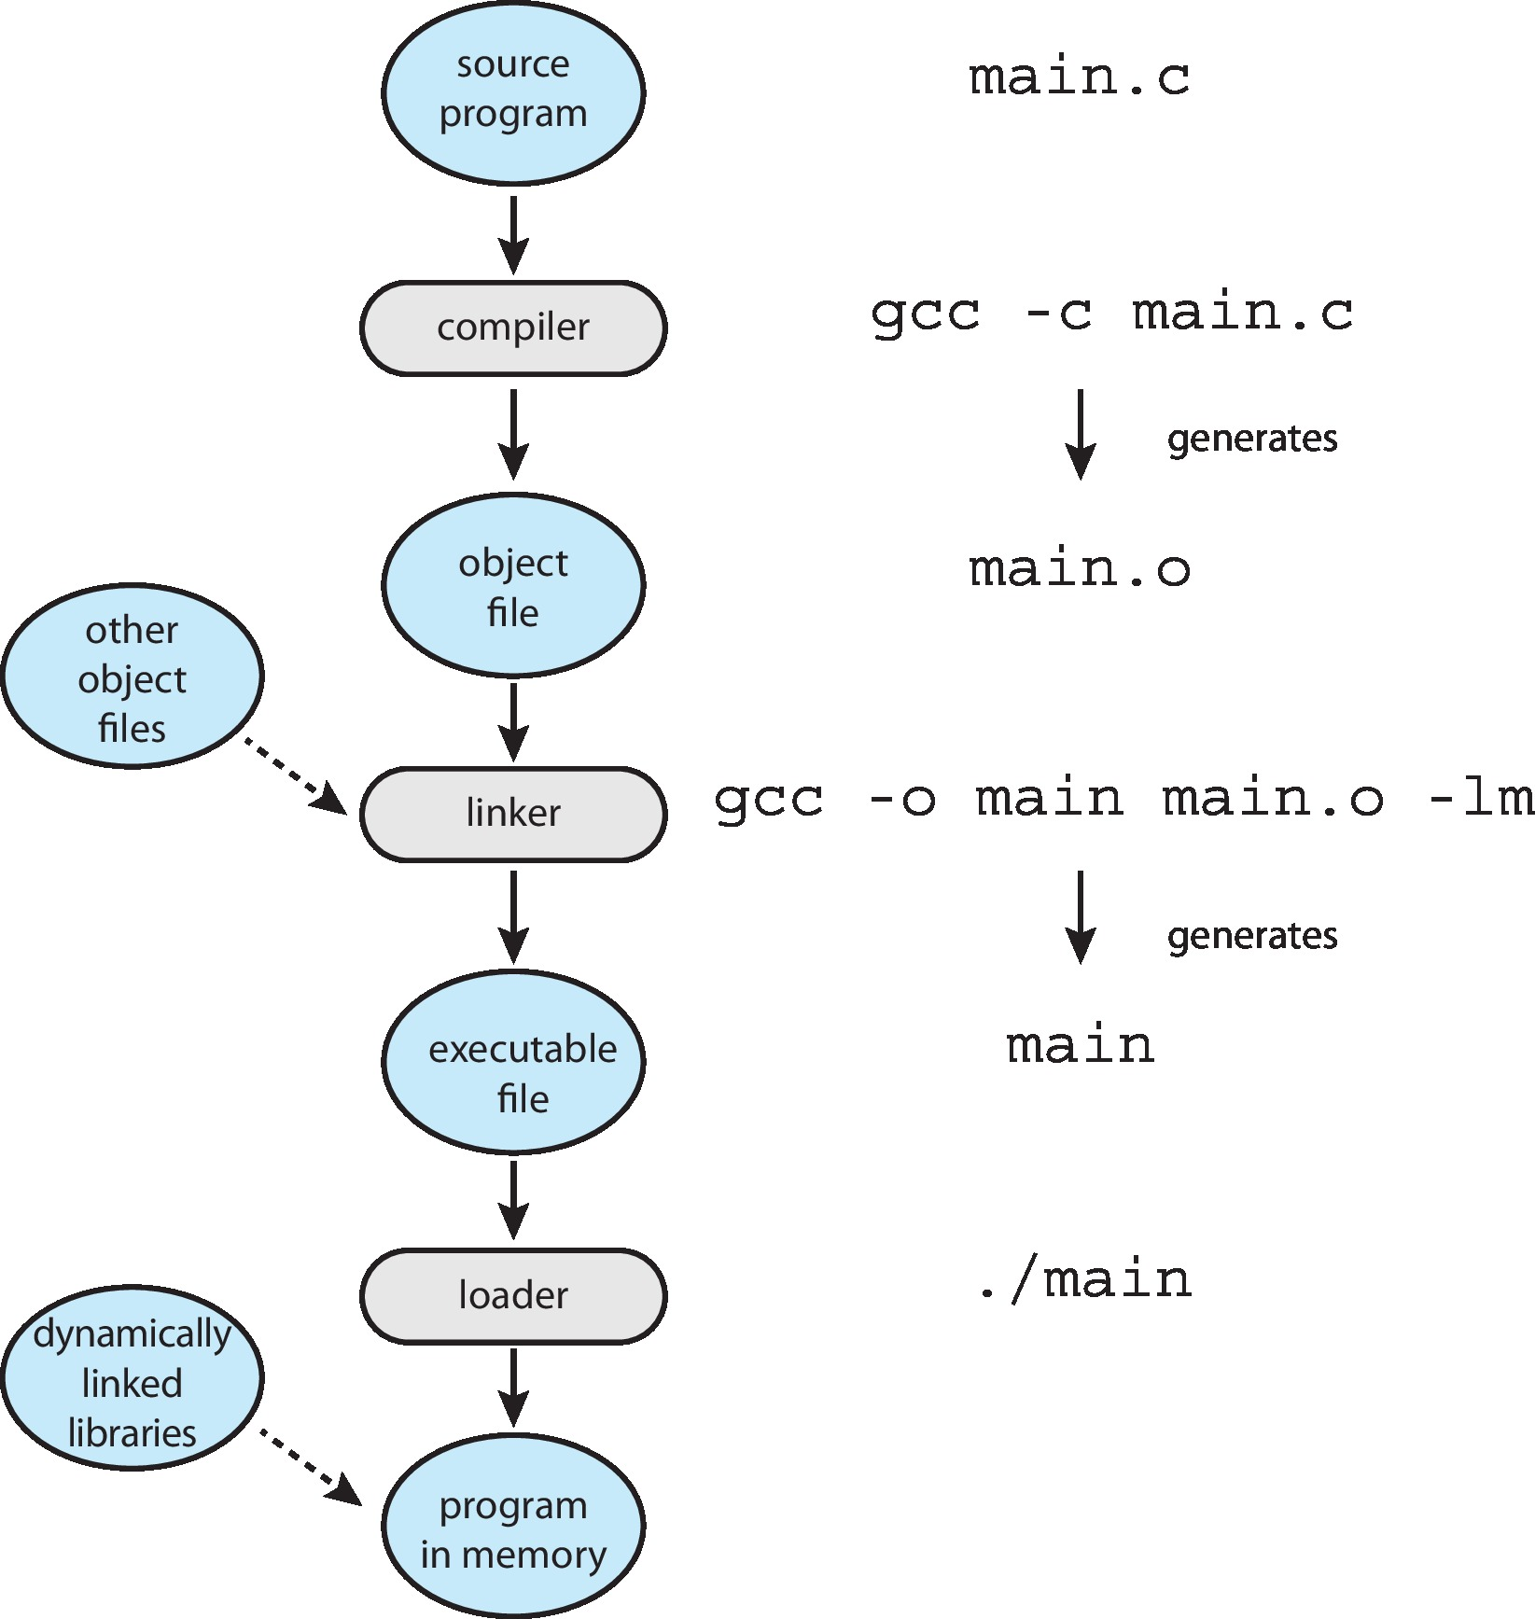
The Role of the Linker and Loader
Notes:
-c means to create an object file.
-lm means to link with the mathematical library.
Ex: g++ -o main.exe main.o
-c will generate the object file. (.o file)

Slide 28
Why Applications are OS Specific
Apps compiled on one system usually not executable on other operating systems
Each operating system provides its own unique system calls
Own file formats, etc.
Apps can be executed in multi-operating system using 3 approaches:
Written in interpreted language like Python, Ruby, and interpreter available on multiple operating systems
App written in language that includes a VM containing the running app (like Java)
Use standard language (like C), compile separately on each operating system to run on each
Application Binary Interface (ABI) is architecture equivalent of API
how different components of binary code can interface for a given operating system on a given architecture, CPU, etc.
methods for passing parameters to system calls,
size of data types, etc.
Notes:
However, because a particular is ABI defined for a certain operating system running on a given architecture, ABIs do little to provide cross-platform compatibility.
Some system calls may be available only in Windows and not in other OS. That’s a drawback of writing in an interpreted language. (All functionality may not be executed in other OS)
Another problem is it is executed line by line so conversion takes time. So usually python is slow in compiling.
For an app written in a VM, we need to have the VM. The problem is the same, the VM must be supported by all OS some functionality may not be available, and it's slow.
3rd approach is used by most of the companies. Ex: MS Excel is available on windows and on mac.

Slide 29
OS Design and Implementation
Design and Implementation of OS is not "solvable", but some approaches have proven successful
Internal structure of different Operating Systems can vary widely
Start the design by defining goals and specifications
Affected by choice of hardware, type of system
The requirements can be divided into two basic groups: user goals and system goals.
User goals – operating system should be convenient to use, easy to learn, reliable, safe, and fast
System goals – operating system should be easy to design, implement, and maintain, as well as flexible, reliable, error-free, and efficient
Specifying and designing an OS is highly creative task of software engineering
Notes:
It is difficult to design OS.

Slide 30
Policy and Mechanism
Policy: What needs to be done?
Example: Interrupt after every 100 seconds
Mechanism: How to do something?
Example: timer
Important principle: separate policy from mechanism
The separation of policy from mechanism is a very important principle, it allows maximum flexibility if policy decisions are to be changed later.
Example: change from 100 to 200 seconds
Notes:
If a process takes more than 100 seconds then the OS shifts to other tasks.
Policy is an abstract concept
Mechanism is a concrete implementation.

Slide 31
Implementation
Much variation
Early OSes in assembly language
Then system programming languages like Algol, PL/1
Now C, C++
Usually, a mix of languages
Lowest levels in assembly
Main body in C
Systems programs in C, C++, scripting languages like PERL, Python, shell scripts
More high-level language easier to port to other hardware
But slower
Notes:
Python is easy to port but it is slower to execute.

Slide 32
Operating System Structure
General-purpose OS is very large program
Various ways to structure ones
Simple structure – MS-DOS
More complex – UNIX
Layered – an abstraction
Microkernel – Mach
Notes:
Apple Mac uses Microkernel

Slide 33
Monolithic Structure – Original UNIX
UNIX – limited by hardware functionality, the original UNIX operating system had limited structuring.
The UNIX OS consists of two separable parts
Systems programs
The kernel
Consists of everything below the system-call interface and above the physical hardware
Provides the file system, CPU scheduling, memory management, and other operating-system functions; a large number of functions for one level
Notes:
Monolithic: Single

Slide 34
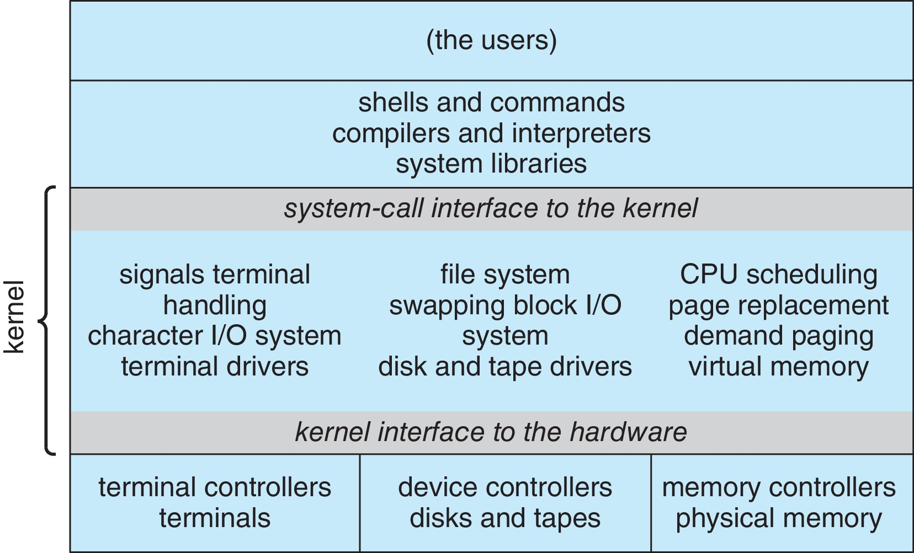
Traditional UNIX System Structure
Beyond simple but not fully layered

Slide 35
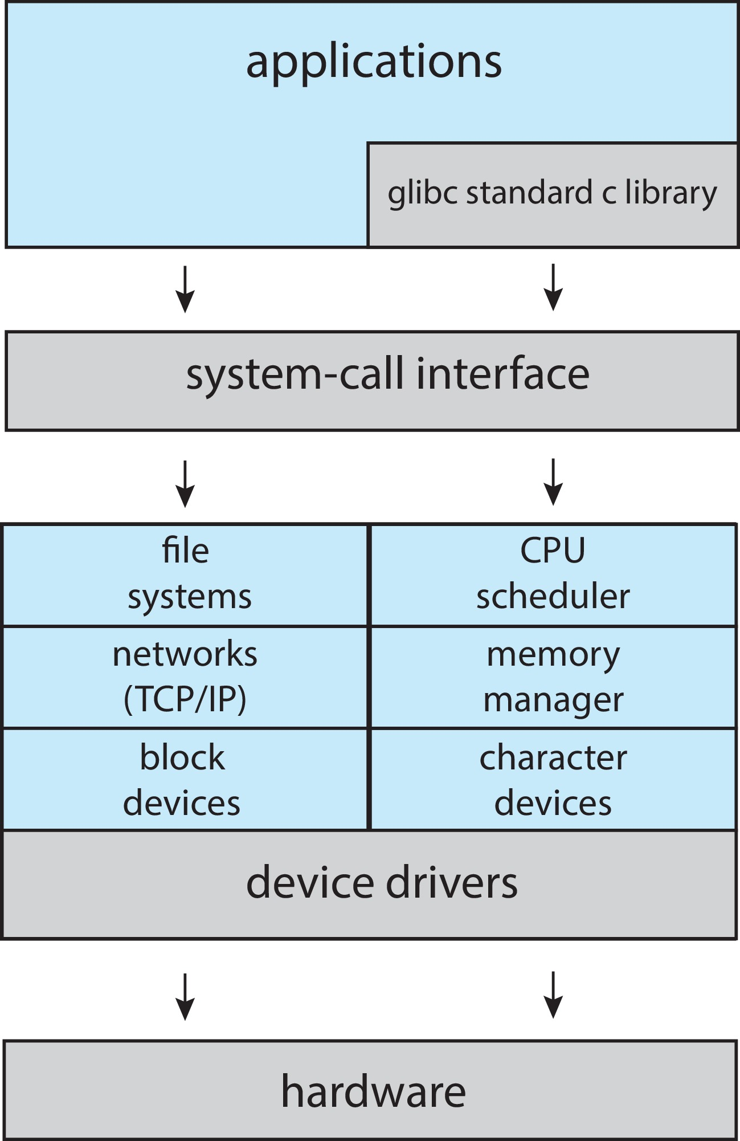
Linux System Structure
Monolithic plus modular design

Slide 36
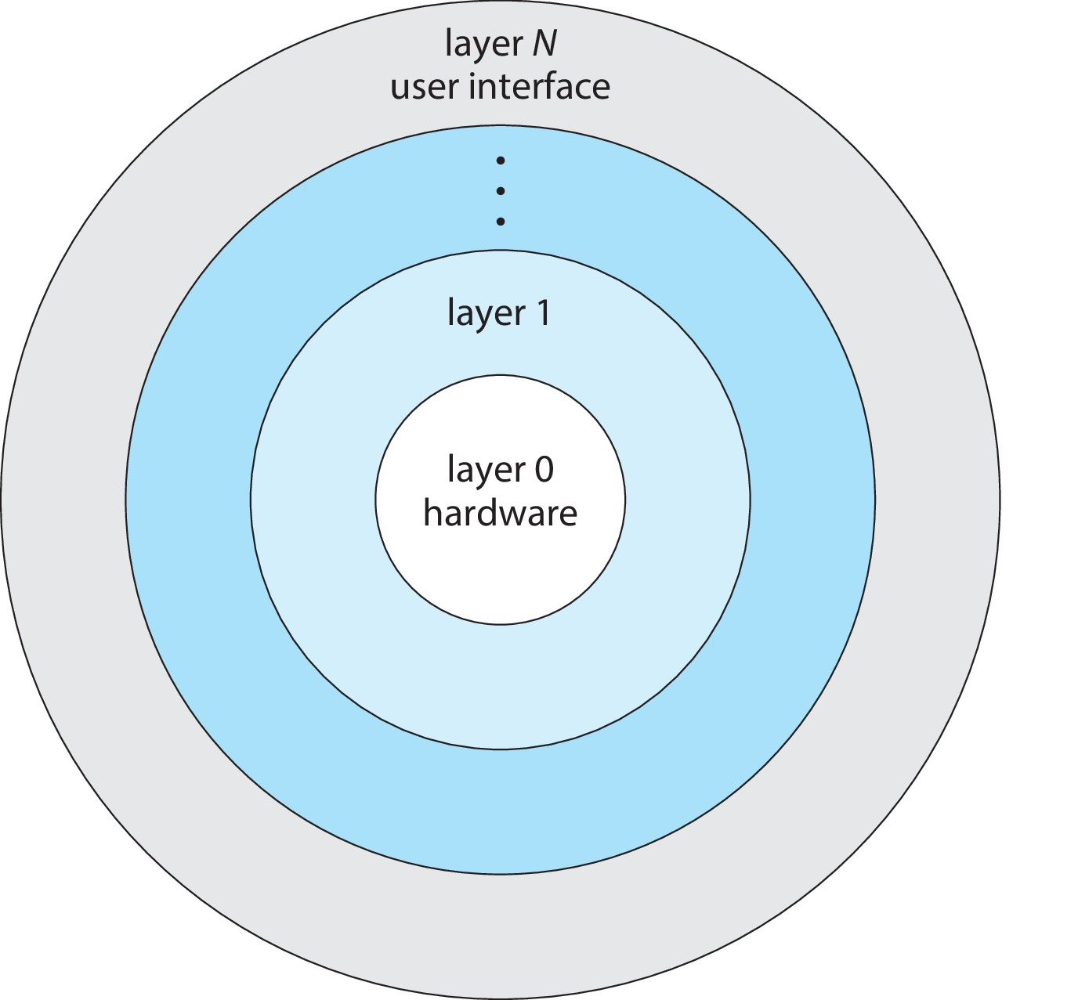
Layered Approach
The operating system is divided into a number of layers (levels), each built on top of lower layers.
The bottom layer (layer 0), is the hardware; the highest (layer N) is the user interface.
With modularity, layers are selected such that each uses functions (operations) and services of only lower-level layers.
Notes:
Layer N will only interact with layer N-1 to provide some modularity.
If one layer is corrupted, other layers must work as it is.
This is abstract, how we will execute it? – No need to know.

Slide 37
Microkernels
Moves as much from the kernel into user space
Mach is an example of microkernel
Mac OS X kernel (Darwin) partly based on Mach
Communication takes place between user modules using message passing
Benefits:
Easier to extend a microkernel
Easier to port the operating system to new architectures
More reliable (less code is running in kernel mode)
More secure
Detriments:
Performance overhead of user space to kernel space communication
Notes:
Perhaps the best-known illustration of a microkerone of which is the Mach microkernel. The operating system is Darwin, the kernel component of the macOS and iOS operating systems.
Darwin, in fact, consists of two kernels,
Communication becomes difficult if we move as much from the kernel into user space.
If we want a new feature, we don’t need to re-compile the kernel.
If one module is corrupted, then other modules/services will execute properly, that’s why it is more secure.

Slide 38
Microkernel System Structure

Slide 39
Modules
Many modern operating systems implement loadable kernel modules (LKMs)
The kernel has a set of core components and can link in additional services via modules – either boot time or run time
Each core component is separate
Each talks to the others over known interfaces
Each is loadable as needed within the kernel
Overall, similar to layers but with more flexible
Linux, macOS, Solaris, etc.
Notes:
Modules are implemented in all the latest OS.

Slide 40
Hybrid Systems
Most modern operating systems are not one pure model
Hybrid combines multiple approaches to address performance, security, usability issues.
Linux is monolithic, plus modular for dynamic loading of functionality
Windows mostly monolithic, plus microkernel for different subsystem that runs as user-mode processes known as personalities
Apple Mac OS X is hybrid, layered, Aqua UI plus Cocoa programming environment
Below is kernel consisting of Mach microkernel and BSD Unix parts, plus I/O kit and dynamically loadable modules (called kernel extensions)

Slide 41
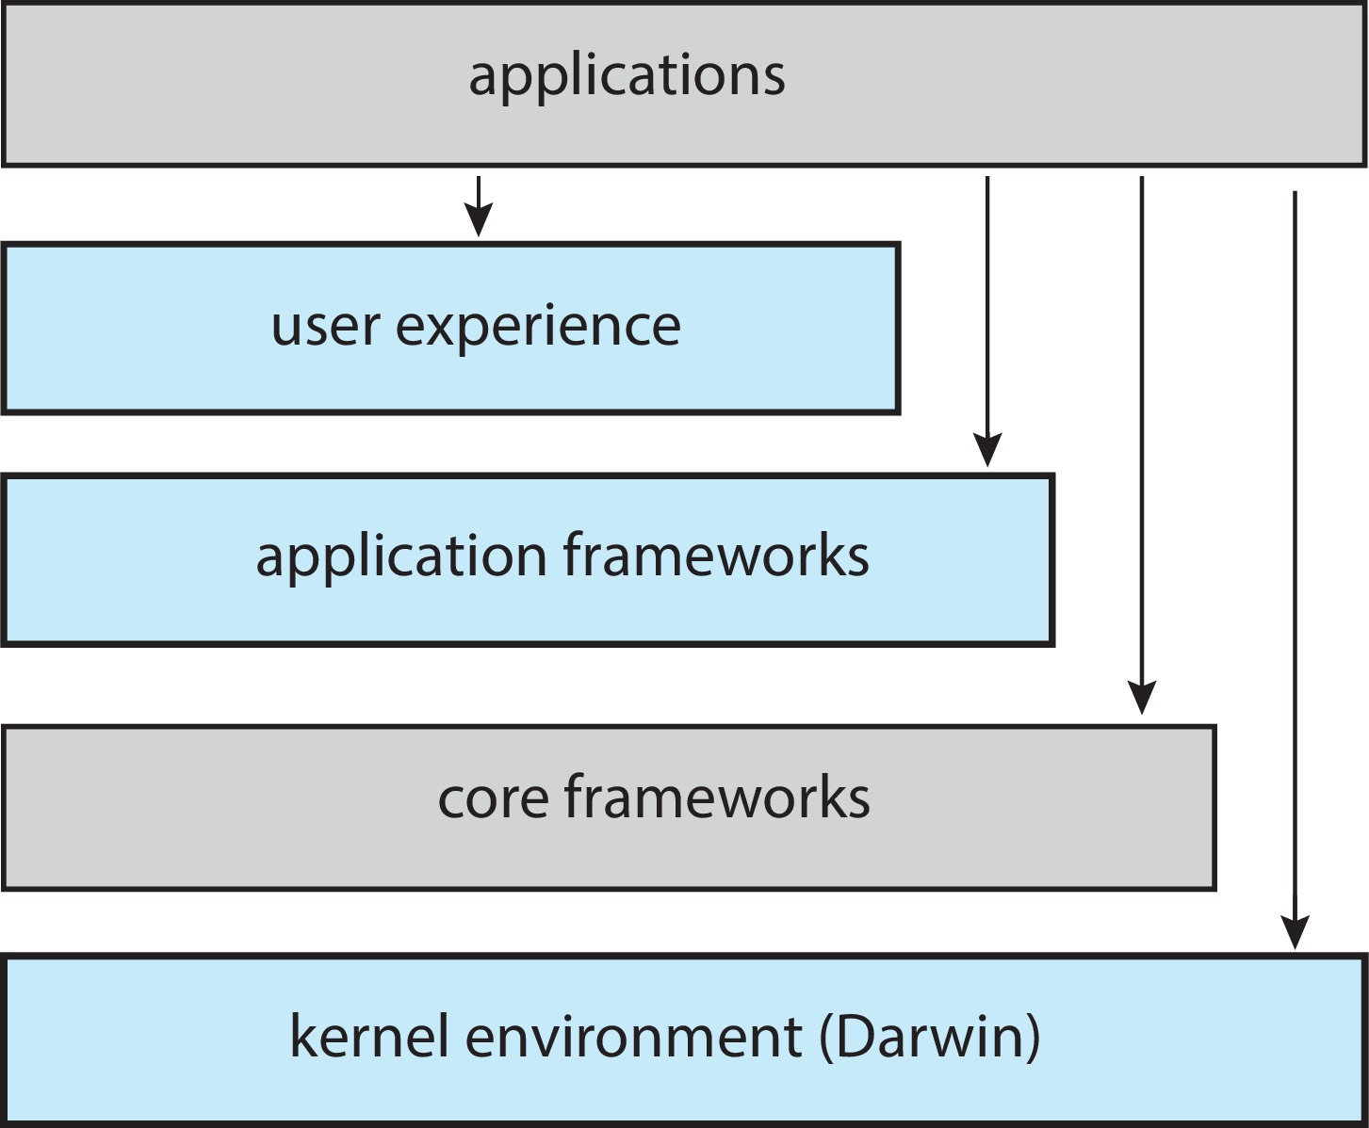
macOS and iOS Structure
Aqua (macOS), Springboard (iOS)
Cocoa and Cocoa Touch (Objective-C, Swift)
Graphics and media, Quicktime & OpenGL
Mac microkernel and BSD UNIX kernel

Slide 42
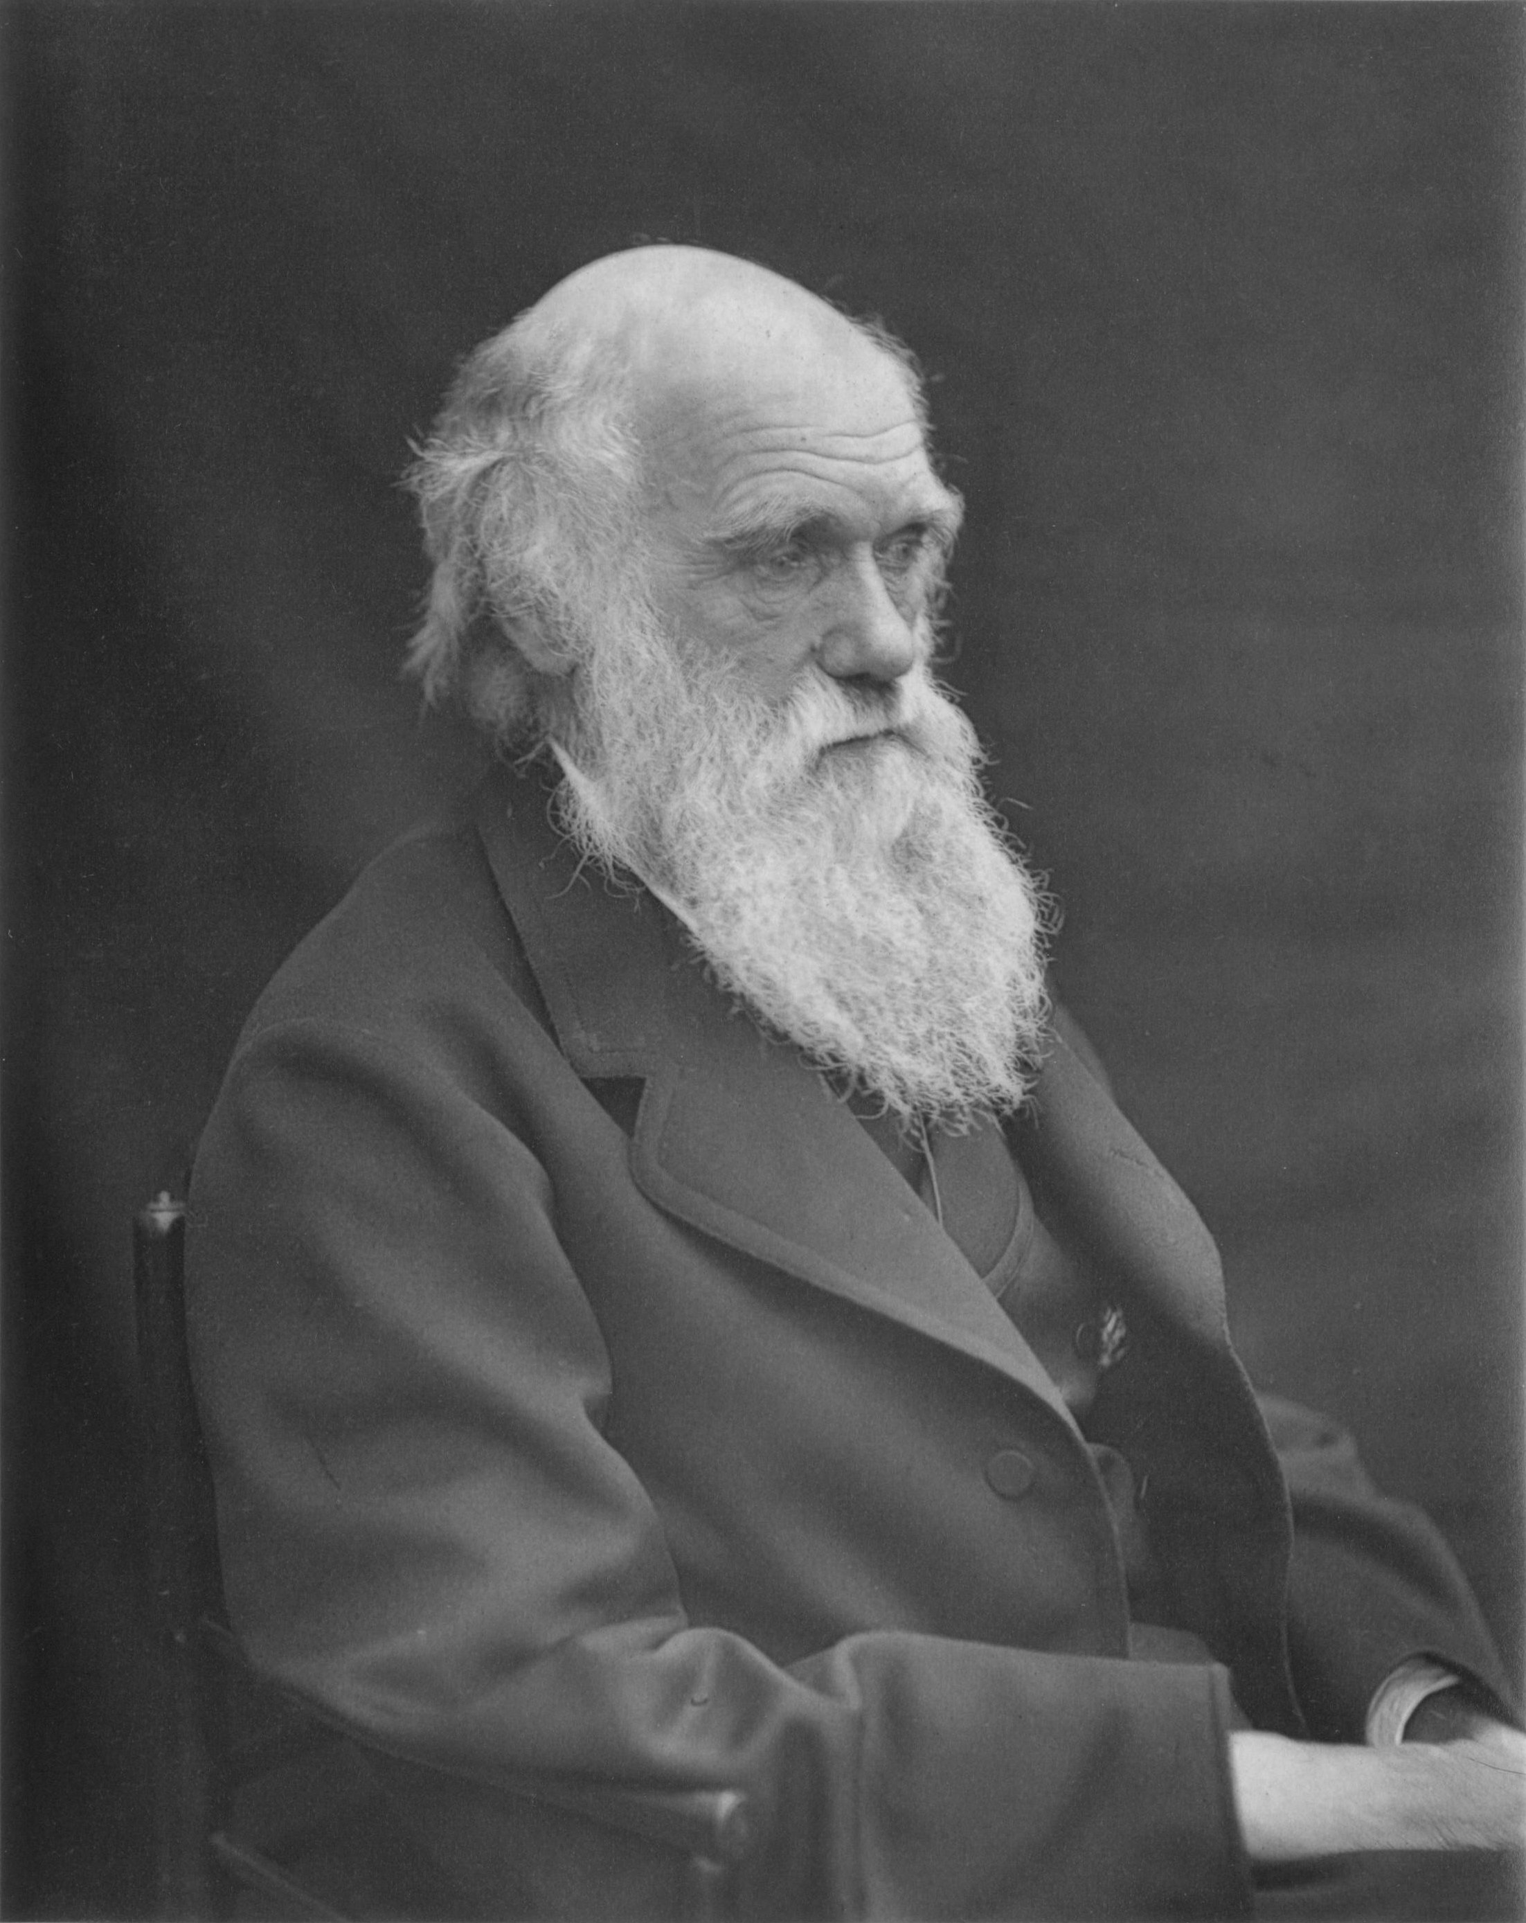
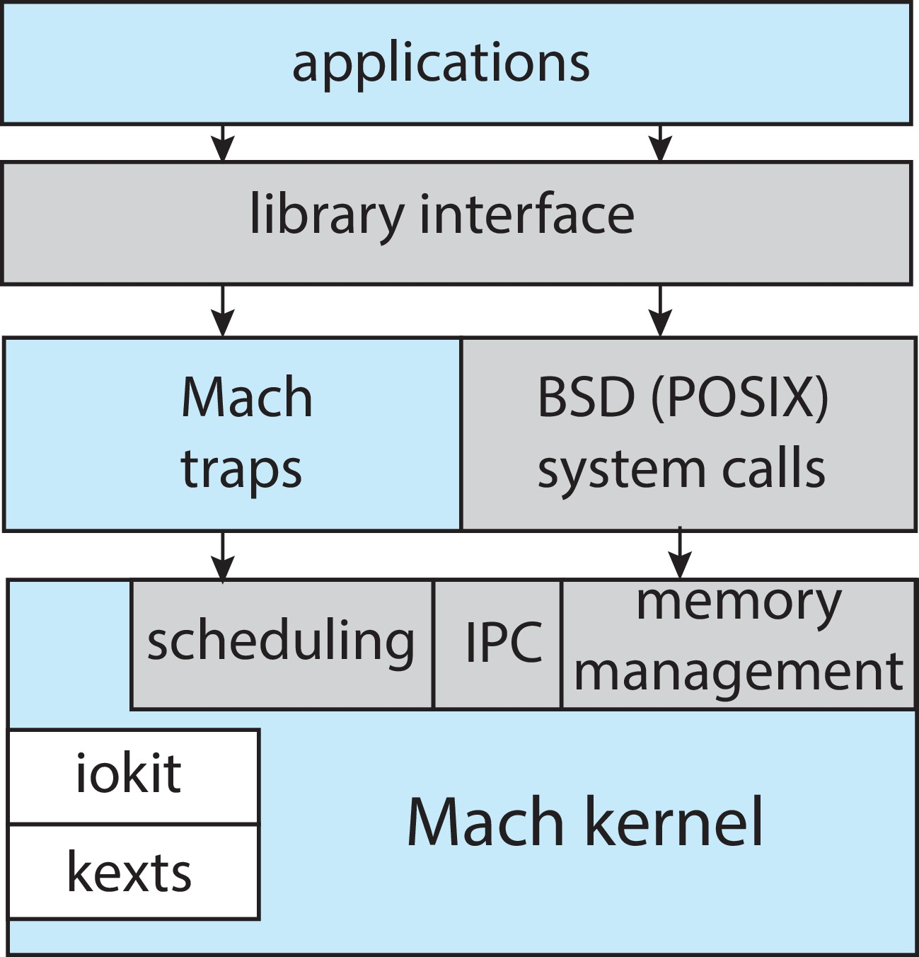
The Structure of Darwin
Source: Wikipedia
Notes:
The kernel environment provides an I/O kit for the development of device drivers and dynamically loadable modules (which macOS refers to as kernel extensions, or kexts).
The white boxes inside the Mach kernel are Loadable kernel models.

Slide 43
Android
Developed by Open Handset Alliance (mostly Google)
Open Source
Similar stack to iOS
Based on Linux kernel but modified
Provides process, memory, device-driver management
Adds power management
Runtime environment includes core set of libraries and Android RunTime (ART)
Apps developed in Java plus Android API
Java class files compiled to Java bytecode then translated to executable .dex file.
Libraries include frameworks for web browser (webkit), database (SQLite), multimedia, smaller libc

Slide 44
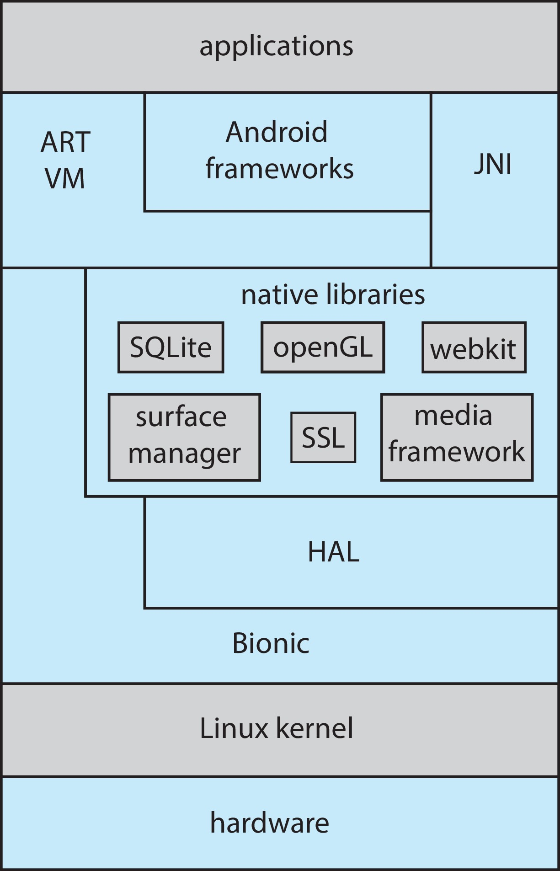
Android Architecture
Hardware Abstraction Layer (HAL)
Bionic: standard C library for Android
Notes:
Android developers can also write Java programs that use the Java native interface (JNI) which allows developers to bypass the virtual machine and instead write Java programs that can access specific hardware features
The bionic library contains malloc used in the C language.
ART VM: Android runtime virtual machine.

Slide 45
Building and Booting an Operating System
Operating systems generally designed to run on a class of systems with variety of peripherals
Commonly, operating system already installed on purchased computer
But can build and install some other operating systems
If generating an operating system from scratch
Write the operating system source code
Configure the operating system for the system on which it will run
Compile the operating system
Install the operating system
Boot the computer and its new operating system

Slide 46
Building and Booting Linux
Download Linux source code (http://www.kernel.org)
Configure kernel via "make menuconfig"
Compile the kernel using "make"
Produces vmlinuz, the kernel image
Compile kernel modules via "make modules"
Install kernel modules into vmlinuz via "make modules_install"
Install new kernel on the system via "make install"

Slide 47
System Boot
When power initialized on system, execution starts at a fixed memory location
Operating system must be made available to hardware so hardware can start it
Small piece of code – bootstrap loader, BIOS, stored in ROM or EEPROM locates the kernel, loads it into memory, and starts it
Sometimes two-step process where boot block at fixed location loaded by ROM code, which loads bootstrap loader from disk
Modern systems replace BIOS with Unified Extensible Firmware Interface (UEFI)
Common bootstrap loader, GRUB, allows selection of kernel from multiple disks, versions, kernel options
Kernel loads and system is then running
Boot loaders frequently allow various boot states, such as recovery mode or single user mode
diagnosing hardware issues, fixing corrupt file systems
Notes:
UEFI has several advantages over BIOS, including better support for 64-bit systems and larger disks.
Perhaps the greatest advantage is that UEFI is a single, complete boot manager and therefore is faster than the multistage BIOS boot process.
GRUB (Grand Unified Bootloader)
Load a small program which will load the bootstrap loader which further will load the OS.

